Slide 1
COMP 4332 / RMBI 4310 Big Data Mining (Spring 2019)
Tutorial 7: CF-based Recommendation
TA: Haojie Pan (hpanad@connect.ust.hk)

Slide 2
Collaborative Filtering based Recommendation
User CF / Item CF
Neural CF

Slide 3
User CF/Item CF

Slide 4
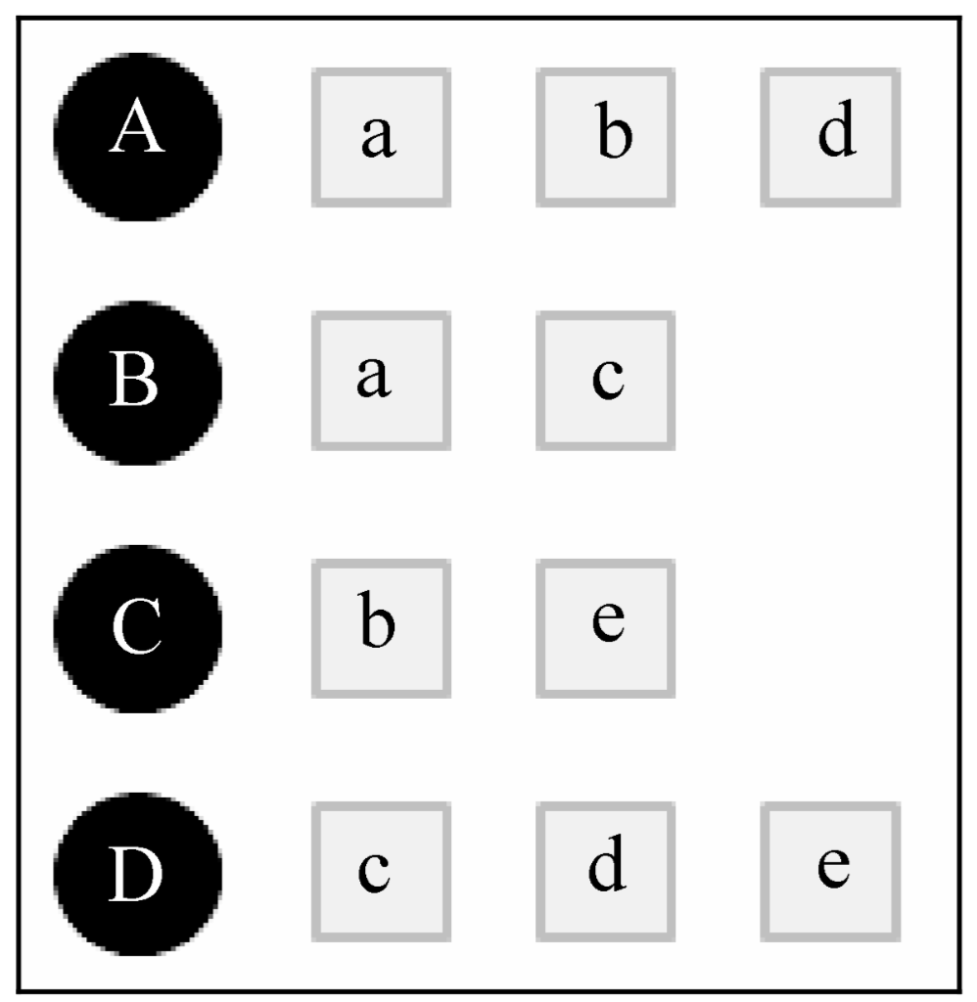
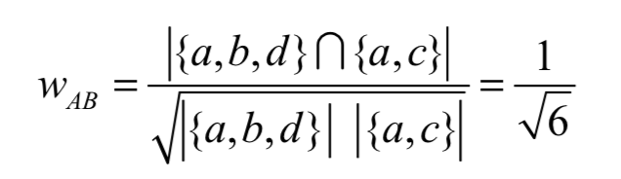
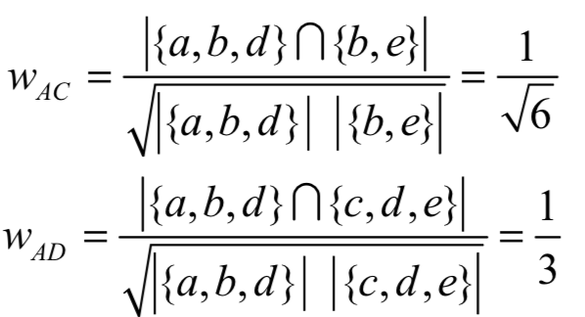
User CF

Slide 5
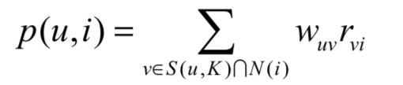
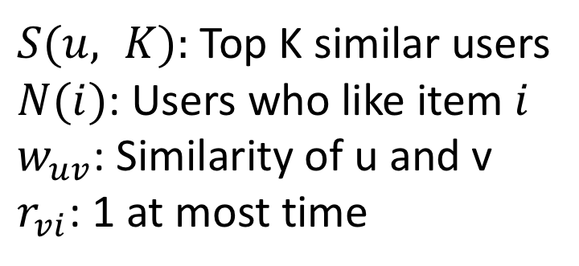
User CF
$S(u, K):$Top K similar users
$N(i)$: Users who like item $i$
$w_{uv}$: Similarity of u and v
$r_{vi}$: 1 at most time

Slide 6
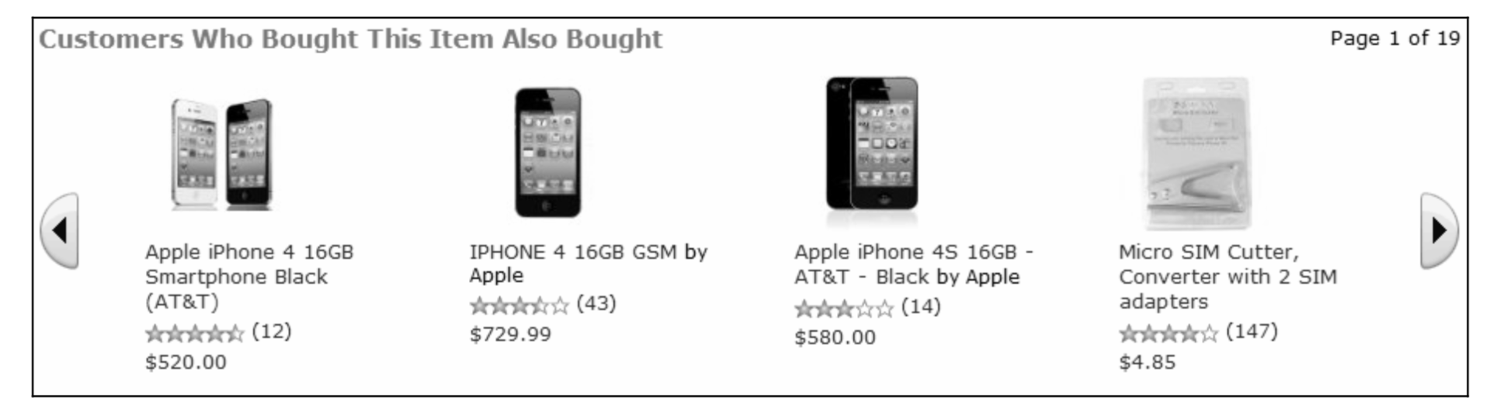
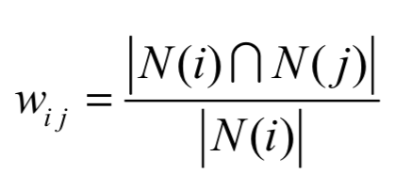
Item CF

Slide 7
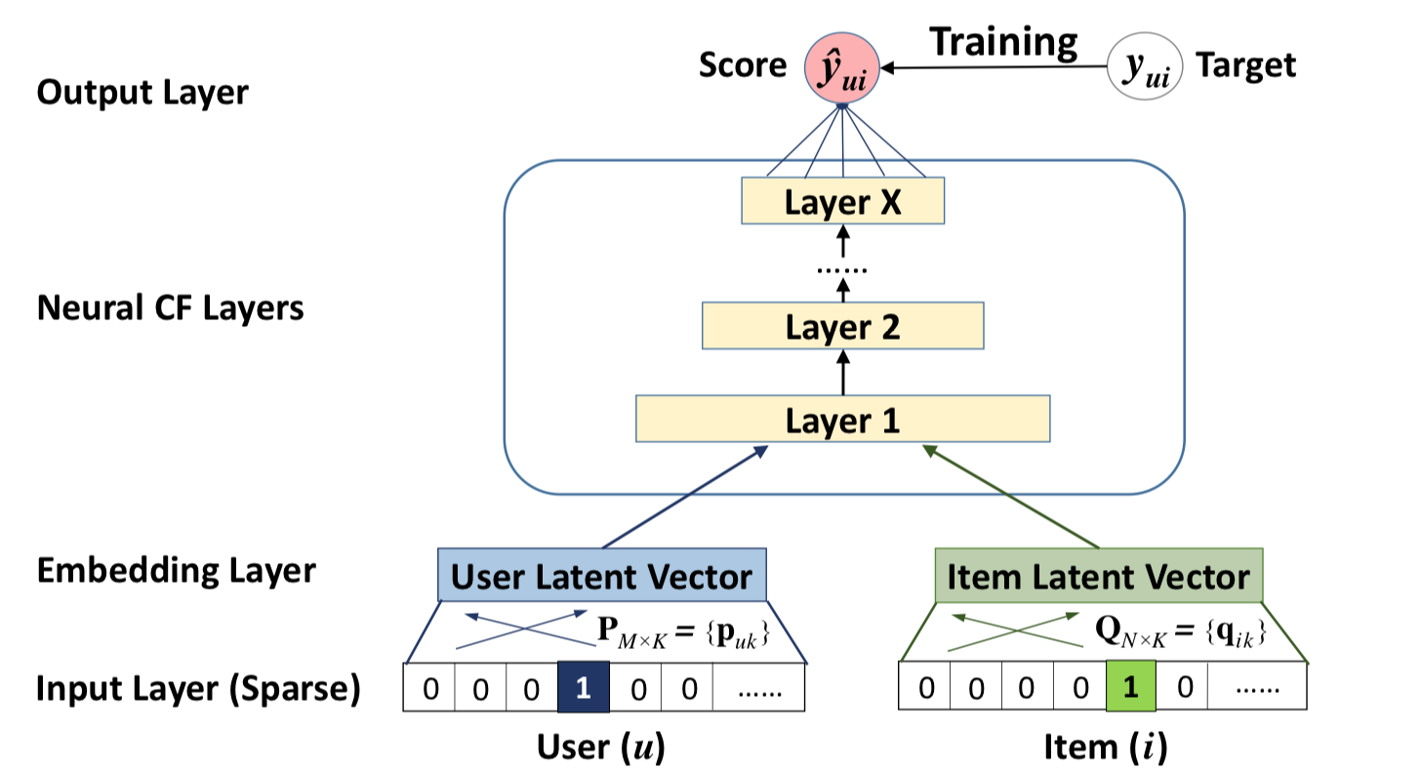
Neural CF

Slide 8
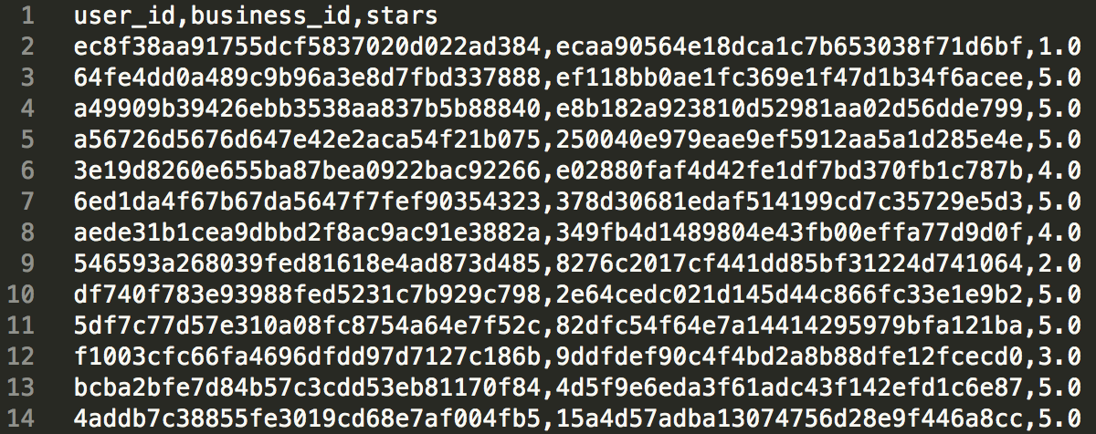
Rating Prediction

Slide 9
Build Neural CF model
# Get the input
user_input = Input(shape=(1,), dtype='int32', name='user_input')
item_input = Input(shape=(1,), dtype='int32', name='item_input')

Slide 10
Build Neural CF model
# Get the latent vector of user and item
user_emb = Embedding(output_dim=embed_size, input_dim=n_users, input_length=1)(user_input)
user_emb = Reshape((embed_size,))(user_emb)
item_emb = Embedding(output_dim=embed_size, input_dim=n_items, input_length=1)(item_input)
item_emb = Reshape((embed_size,))(item_emb)

Slide 11
Output Layer Type 1: Dot
# get the output
model_output = Dot(axes=1)([user_emb, item_emb])

Slide 12
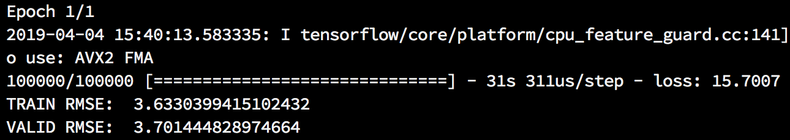
Test Your Code
$ python tut7_skeleton.py

Slide 13
Output Layer Type 2: MLP
# Concatenation
mlp_input = Concatenate()([user_emb, item_emb])

Slide 14
Output Layer Type 2: MLP
# the first fully-connected layer
dense_1 = Dense(64, activation='relu')(mlp_input)
dense_1_dp = Dropout(0.15)(dense_1)

Slide 15
Output Layer Type 2: MLP
# the second fully-connected layer
dense_2 = Dense(32, activation='relu')(dense_1_dp)
dense_2_dp = Dropout(0.15)(dense_2)

Slide 16
Output Layer Type 2: MLP
# Get the output
model_output = Dense(1)(dense_2_dp)

Slide 17
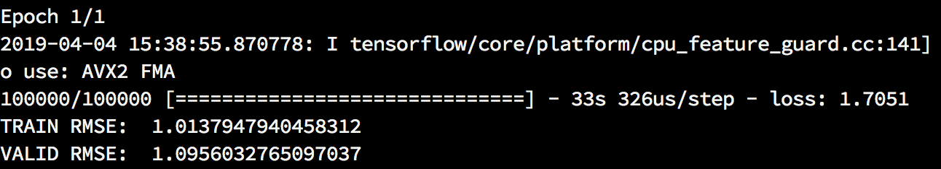
Test Your Code
$ python tut7_skeleton.py

Slide 18
Thank You

